Slide 1

SRM INSTITUTE OF SCIENCE AND TECHNOLOGY COLLEGE OF ENGINEERING AND TECHNOLOGY
DEPARTMENT OF COMPUTATIONAL INTELLIGENCE 18AIP107L-Project
Classification of Gram Positive and Gram Negative Bacteria Using Few Shot Learning
Lakshmi Ranga Sai Gajulapalli : RA2011047010143
Tharun Mathi : RA2011047010086
Guide name : Dr.R.Beaulah Jeyavathana
(Assistant Professor)
Faculty ID : 102829

Slide 2
What is Bacteria ?
Bacteria are tiny, single-celled living organisms. There are millions of different types of bacteria. Many can be found in and on your body and are beneficial to you. These bacteria make up your microbiome, which keeps your body healthy. Other bacteria can make you sick. Healthcare providers can treat many bacterial infections with antibiotics. Scientists estimate you have 10 times more bacterial cells than human cells in your body.

Slide 3
Classification of Bacteria
Scientists classify bacteria by the color they turn after they apply special chemicals (stains) to them. One common staining process is called Gram staining. Bacteria may be classified as gram-positive or gram-negative .
Gram staining also helps guide treatment because gram-positive and gram-negative bacteria respond differently to certain types of antibiotics.
ram-negative and gram-positive bacteria have different membranes because they have different cell wall structures.
Gram-positive bacteria have a thick layer of peptidoglycan in their cell walls, while gram-negative bacteria have a thin layer of peptidoglycan and an outer membrane that is absent in gram-positive bacteria12.
Peptidoglycan is a polymer that gives strength and rigidity to the cell wall. The outer membrane of gram-negative bacteria is composed of lipopolysaccharides a

Slide 4
Types of bacteria
One method that use to classify bacteria is gram staining method,which is the most commonly performed laboratory procedure.
There are two types of bacteria named as:
GRAM POSITIVE BACTERIA
GRAM NEGATIVE BACTERIA
GRAM Refers to: specimen staining method Developed by scientist “GRAM”.

Slide 5
Types of Bacteria
GRAM POSITIVE BACTERIA
GRAM NEGATIVE BACTERIA
Gram-positive bacteria constitute a cell wall, which is mainly composed of multiple layers of peptidoglycan that forms a rigid and thick structure.
gram-positiveGram-positive bacteria have the following characteristics:Membranes: Gram-positive bacteria do not haveTrusted Source a protective outer membrane
.Cell wall: They have a thick peptidoglycan cell wall.Shape: Gram-positive bacteria are sphere- or rod-shaped, or they have branching filaments.
Toxins: These bacteria also contain certain toxins that can cause a number of food-borne diseases.
Toxins presentTrusted Source in Gram-positive bacteria include:emetic toxindiarrheal enterotoxinsneurotoxinsenterotoxin
gram-negative bacteria, the cell wall is made up of an outer membrane and several layers of peptidoglycan
. The outer membrane is composed of lipoproteins, phospholipids, and LPS.
The peptidoglycan stays intact to lipoproteins of the outer membrane that is located in the fluid-like periplasm between the plasma membrane and the outer membrane.
The periplasm is contained with proteins and degrading enzymes which assist in transporting molecules.
Membrane: Gram-negative bacteria have two membranesTrusted Source — one external and one internal.Cell wall: These bacteria also have a thinner peptidoglycan cell wall than Gram-positive bacteria, which sits between their two membranes.Shape: They can be spherical-, rod-, or spiral-shaped.
Toxins: If something disturbs the cell wall of Gram-negative bacteria, they can release endotoxins.

Slide 6
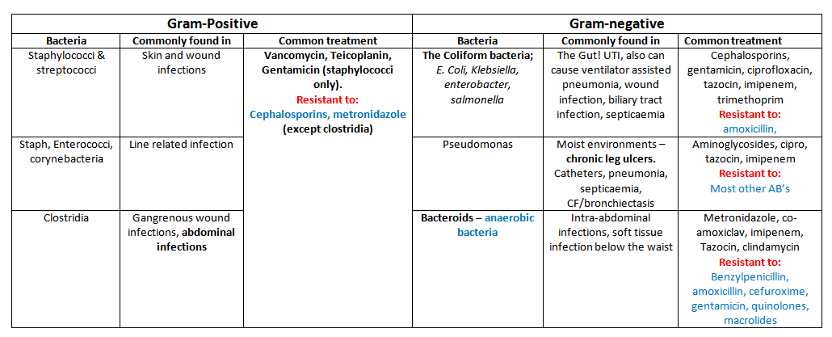
Diseases

Slide 7
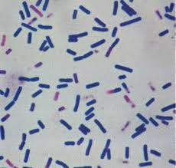
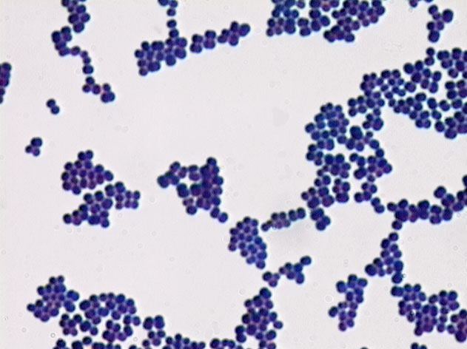
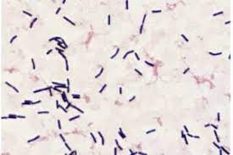
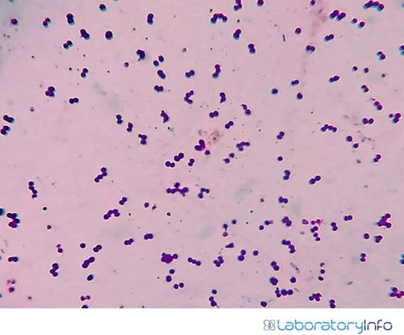
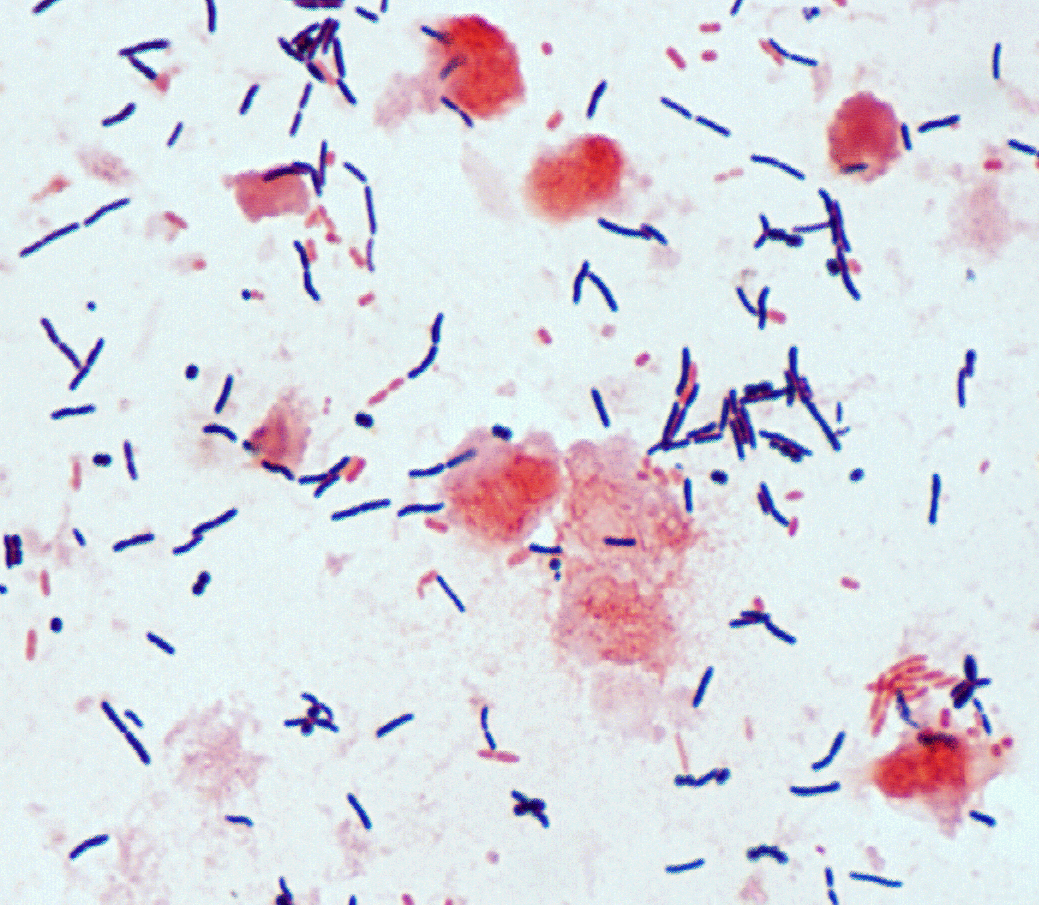
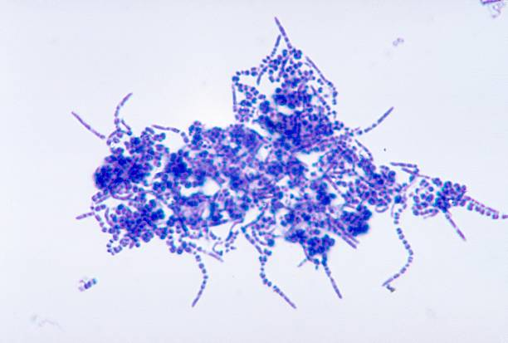
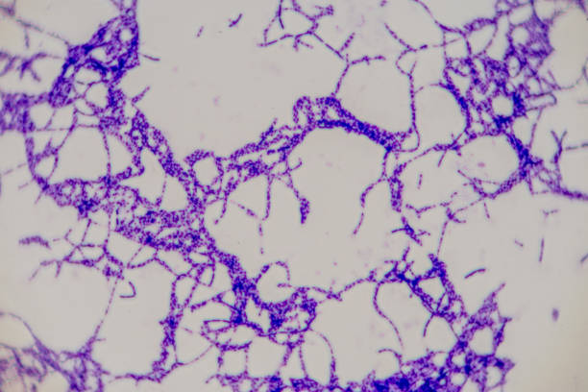
GRAM POSITIVE

Slide 8
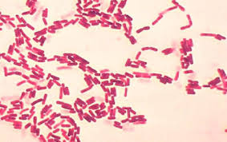
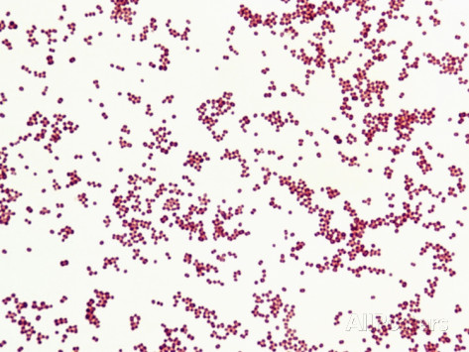
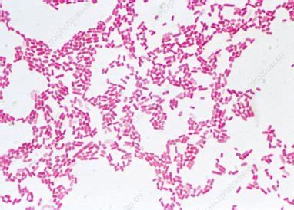
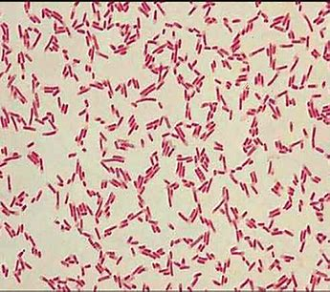
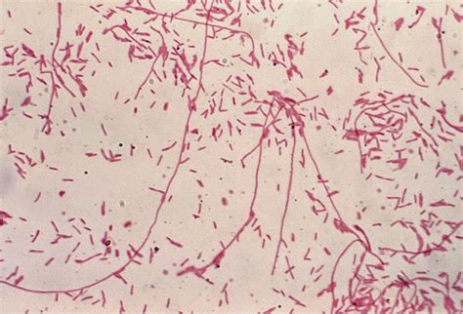
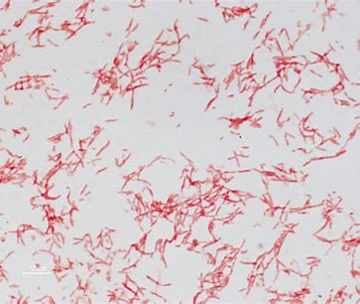
GRAM NEGATIVE

Slide 9
Table of contents
Abstract
Requirement Gathering
Literature Survey
Research Gap
Objectives and Problem Statement
Architecture Diagram
Modules Description
Results and Discussions
Screenshots
References

Slide 10
Abstract
This study introduces a novel method for classifying Gram-positive and Gram-negative bacteria using few-shot learning, a machine learning technique suitable for limited data scenarios. It employs a diverse dataset of bacterial images, extracts essential features using a Siamese network, and demonstrates superior accuracy and generalization compared to traditional methods. This approach has promising clinical applications, including rapid bacterial identification and antibiotic susceptibility testing, potentially revolutionizing microbiology and healthcare.

Slide 11
REQUIREMENT GATHERING
Data Collection and Preparation:
Collect a diverse dataset of bacterial images, including Gram-positive and Gram-negative samples.
Ensure dataset quality, labeling accuracy, and representation of various bacterial species.
Normalize and preprocess images to remove noise and standardize formats.
Few-Shot Learning Framework:
Select a suitable few-shot learning algorithm and architecture, such as Siamese networks or matching networks.
Implement the framework to handle limited labeled data effectively.
Integrate a pre-trained CNN model for feature extraction.
Model Training and Validation:
Split the dataset into training, validation, and test sets.
Train the few-shot learning model using the training data while optimizing hyperparameters.
Validate the model's performance on the validation set to ensure robustness.
Generalization Testing:
Evaluate the model's ability to generalize across different bacterial strains and datasets.
Assess its accuracy in classifying unseen Gram-positive and Gram-negative samples.
Clinical Applicability:
Collaborate with healthcare professionals to understand clinical requirements.
Ensure the model's compatibility with existing diagnostic workflows.
Validate the model's performance on clinical samples and assess its impact on patient care.
Automation and Integration:
Develop a user-friendly interface for easy adoption by laboratory personnel.
Integrate the model into existing laboratory systems and workflows for seamless automation.
Performance Metrics:
Define evaluation metrics, such as accuracy, precision, recall, and F1-score, for assessing model performance.
Set performance benchmarks based on clinical and research requirements.
Ethical Considerations:
Address ethical concerns related to data privacy and patient confidentiality.
Ensure that the model's predictions are transparent and explainable to build trust among users.

Slide 12
LITERATURE SURVEY
Name of Publication | Author | Year | Inference
Classification of gram-positive and gram-negative bacterial images based on machine learning algorithm | Son Ali Akbar; Kamarul Hawari Ghazali | 2022 | Bacteria are small living things that cannot be seen directly, and bacteria are the main cause of various diseases, so a tool is needed that can detect them. In fact, the manual classification process necessitates a significant amount of time. In addition, the traditional diagnosis has a limitation on accurate detection. Identifying and classifying bacteria is critical for assisting the medical field. Therefore, this study aims to utilize the machine learning approach's computerized technique proposed. The method provided features extraction and classification. This research used gram-positive and gram-negative bacterial species. Two texture features are used to extract characteristics of each bacterial class: the histogram feature and the Gray Level Co-occurrence Matrix (GLCM). In addition, the Naive Bayes classifier was utilized to classify the features extracted. The final classification accuracy result is 77.5% using the histogram feature and 72% using GLCM features. Therefore, this approach might be possible to assist the clinician and microbiologist.
Gram positive and Gram negative bacteria differ in their sensitivity to cold plasma | Anne Mai-Prochnow,a,1 Maryse Clauson,1,2 Jungmi Hong,1,3 and Anthony B. Murphy1 | 2016 | Cold atmospheric-pressure plasma (CAP) shows antimicrobial potential, with CAP effectiveness linked to bacterial cell wall thickness. Gram-positive Bacillus subtilis with thick cell walls are more CAP-resistant than Gram-negative Pseudomonas aeruginosa with thinner walls. Pseudomonas libanensis in planktonic culture is more susceptible than Gram-positive Staphylococcus epidermidis. Mixed biofilms confirm Gram-positive resistance, but co-culture makes P. aeruginosa more resistant. Emission spectra reveal OH and O in CAP, contributing to cell wall bond breakage. CAP inactivation correlates with cell wall thickness but involves cell membranes and biofilm matrices
Effects of cell structure of gram-positive and gram-negative bacteria based on their dielectric properties | Katja Dahlke, Christiane Geyer, Stephan Dees | 2012 | They hypothesize that the distinct cellular composition of microorganisms could be identified by dielectric spectroscopy. Gram-positive and Gram-negative bacterial strain permittivity measurement was performed using a network analyzer and a coaxial probe in the frequency range from 50 MHz to 300 MHz. All bacterial strains in suspension demonstrated correlation between cell count and permittivity values during the growth phase. When determining isolated cell pellets, a clear discrimination between Gram-positive and Gram-negative strains was possible in a frequency range between 50 MHz and 100 MHz.

Slide 13
LITERATURE SURVEY
Name of Publication | Author | Year | Inference
Classifying Gram Positive Cocci and Gram Negative Bacilli in Gram Stained Smear Images | Ibuki Kawano,Eri Kurumida, Syoma Terada,Kouichi Hirata | 2022 | In this paper, They classify Gram positive cocci and Gram negative bacilli in Gram stained smear images. We adopt pre-trained models of VGG16, VGG19, MobileNet and DenseNet by using ImageNet as learning models. Then, we give experimental results for classifying them, and the classification by MobileNet and DenseNet are more successful than that by VGG16 and VGG19.
The bactericidal effect of a positive and negative corona on Gram-positive and Gram-negative bacteria | Elena V ,Maria A. Yurova,Andrey Ya | 2012 | This study was aimed to evaluate an effect of corona discharge on viability of the pathogenic bacteria Staphylococcus aureus (Gram-positive) and Pseudomonas aeruginosa (Gram-negative) seeded on nutritive agar and to evaluate a role of the charged particles and neutral active species in a total bactericidal effect. To split the effects of the charged particles and neutral species on the microorganisms, we have done the experiments with corona in the rest air and in airflow removing neutral active agents from the agar surface to be treated.
Tyrosine Mediated Gold, Silver and Their Alloy Nanoparticles Synthesis: Antibacterial Activity Toward Gram Positive and Gram Negative Bacterial Strains | Hemant K. Daima, PR. Selvakannan, Zahra Homan | 2011 | Shape and size-controlled synthesis of metal and metal alloy nanoparticles have gained significant attention due to their unique physico-chemical properties. Most of these synthesis routes have thus far explored use of toxic chemicals for metal nanoparticles synthesis, which limit their biological applications. With the increasing focus on eco-friendly routes towards nanomaterials synthesis and their biological applications, we show that metal (gold and silver) and their alloy nanoparticles with controlled composition can be synthesized using tyrosine amino acid. Antimicrobial activities of these nanoparticles were tested against model Gram positive bacteria Staphylococcus albus and Gram negative bacteria Escherichia coli.

Slide 14
LITERATURE SURVEY
Name of Publication | Author | Year | Inference
Classifying Gram Positive Cocci and Gram Negative Bacilli in Gram Stained Smear Images | Ibuki Kawano,Eri Kurumida, Syoma Terada,Kouichi Hirata | 2022 | In this paper, They classify Gram positive cocci and Gram negative bacilli in Gram stained smear images. We adopt pre-trained models of VGG16, VGG19, MobileNet and DenseNet by using ImageNet as learning models. Then, we give experimental results for classifying them, and the classification by MobileNet and DenseNet are more successful than that by VGG16 and VGG19.
The bactericidal effect of a positive and negative corona on Gram-positive and Gram-negative bacteria | Elena V ,Maria A. Yurova,Andrey Ya | 2012 | This study was aimed to evaluate an effect of corona discharge on viability of the pathogenic bacteria Staphylococcus aureus (Gram-positive) and Pseudomonas aeruginosa (Gram-negative) seeded on nutritive agar and to evaluate a role of the charged particles and neutral active species in a total bactericidal effect. To split the effects of the charged particles and neutral species on the microorganisms, we have done the experiments with corona in the rest air and in airflow removing neutral active agents from the agar surface to be treated.
Tyrosine Mediated Gold, Silver and Their Alloy Nanoparticles Synthesis: Antibacterial Activity Toward Gram Positive and Gram Negative Bacterial Strains | Hemant K. Daima, PR. Selvakannan, Zahra Homan | 2011 | Shape and size-controlled synthesis of metal and metal alloy nanoparticles have gained significant attention due to their unique physico-chemical properties. Most of these synthesis routes have thus far explored use of toxic chemicals for metal nanoparticles synthesis, which limit their biological applications. With the increasing focus on eco-friendly routes towards nanomaterials synthesis and their biological applications, we show that metal (gold and silver) and their alloy nanoparticles with controlled composition can be synthesized using tyrosine amino acid. Antimicrobial activities of these nanoparticles were tested against model Gram positive bacteria Staphylococcus albus and Gram negative bacteria Escherichia coli.

Slide 15
LITERATURE SURVEY
Name of Publication | Author | Year | Inference
Predict Gram-Positive and Gram-Negative Subcellular Localization via Incorporating Evolutionary Information and Physicochemical Features Into Chou's General PseAAC | Ronesh Sharma; Abdollah Dehzangi; James Lyons | 2015 | They used structural and evolutionary based features to represent the sequences of gram-positive and gram-negative subcellular localizations. To do this, they proposed a normalization method to construct a normalize Position Specific Scoring Matrix (PSSM) using the information from original PSSM.
Simple, Fast And Highly Sensitive Detection Of Gram-Negative Bacteria By A Novel Electrical Biosenso | Jayne Wu,Cheng Cheng; Quan Yuan | 2018 | Recognition of Gramnegative bacteria is based on specific detection of lipopolysaccharides (LPS) by LPS-specific aptamer probe immobilized on electrode sensors. An inhomogeneous AC electric field is applied on sensor electrodes and induces positive dielectrophoresis that attracts LPS particles to the sensor electrodes for rapid detection.
Development and Testing of ZnO Nanorods Based Biosensor on Model Gram-Positive and Gram-Negative Bacteria | Rashi Borgohain; Sunandan Baruah | 2011 | Shape and size-controlled synthesis of metal and metal alloy nanoparticles have gained significant attention due to their unique physico-chemical properties. Most of these synthesis routes have thus far explored use of toxic chemicals for metal nanoparticles synthesis, which limit their biological applications. With the increasing focus on eco-friendly routes towards nanomaterials synthesis and their biological applications, we show that metal (gold and silver) and their alloy nanoparticles with controlled composition can be synthesized using tyrosine amino acid. Antimicrobial activities of these nanoparticles were tested against model Gram positive bacteria Staphylococcus albus and Gram negative bacteria Escherichia coli.

Slide 16
LITERATURE SURVEY
Name of Publication | Author | Year | Inference
Antibacterial Activity of Ocimum basilicum L. Extracts Grown in Aquaponic Conditions Against Gram-positive and Gram-negative Species | Simona Dunca; Lacramioara Oprica; Ira-Adeline Simionov | 2022 | In this system, the nutrients required for plant growth result from the metabolism of the food by the fish. The experiment was carried out at the Dunărea de Jos University, Galati, where a significant biomass of basil (Ocimum basilicum) was obtained in an aquaponic regime, thus using the metabolic residues from intensive aquaculture. Basil (O. basilicum) is a fast-growing commercial crop commonly grown in aquaponic systems by commercial growers.

Slide 17
Research Gap
Research often relies on limited bacterial species and strains for classification. A research gap exists in expanding the dataset to include a broader range of bacterial species, strains, and environmental conditions to test the generalizability of FSL models.
While Siamese and Prototypical Networks are commonly used in FSL, there's room for research into novel architectures or hybrid models tailored specifically for bacterial classification, considering factors like cell wall structure and membrane composition.
Exploring the potential of transfer learning from pre-trained models in related domains (e.g., medical imaging) to improve FSL performance in bacterial classification could be a valuable research direction.

Slide 18
Objective / Problem Statement
The objective is to develop a machine learning model capable of accurately distinguishing between Gram-positive and Gram-negative bacteria with limited training data using few-shot learning techniques.
This involves data collection, preprocessing, and setting up a few-shot learning problem. The model's architecture is carefully designed and optimized, and it is trained, validated, and evaluated.
Data augmentation and transfer learning may be employed to improve performance. Interpretability and ethical considerations are addressed, and the model can be deployed for practical applications in microbiology and healthcare while continuously monitoring and improving its performance.

Slide 19
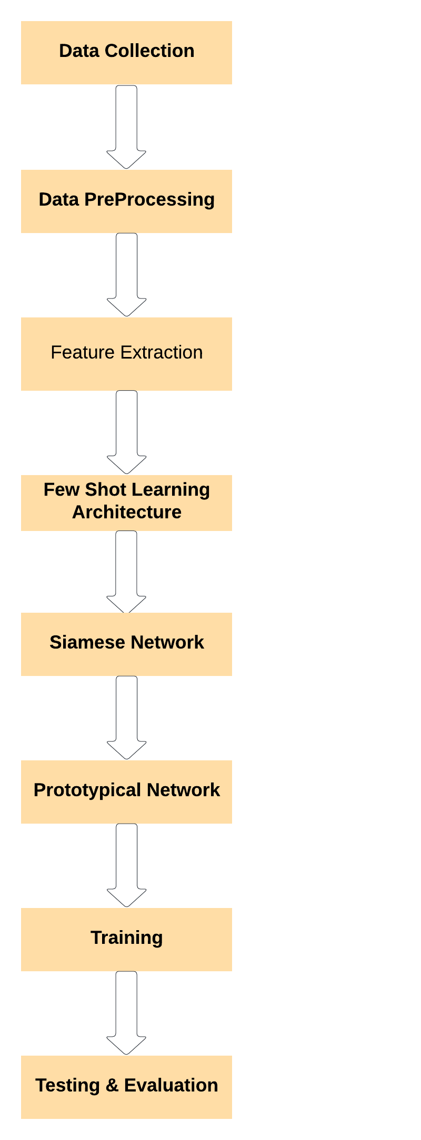
Architecture Diagram

Slide 20
MODULES
Data Preparation Module:
Data Loading: A module to load and organize your bacterial image dataset, separating it into training and testing sets.
Data Augmentation: Techniques to artificially expand your dataset by applying random transformations like rotation, scaling, and flipping.
Feature Extraction Module:
Pre-trained CNN: Use a pre-trained Convolutional Neural Network (CNN) model (e.g., VGG, ResNet, Inception) to extract high-level features from bacterial images.
Few Shot Learning Framework Module:
Siamese Network or Prototypical Network: Implement the chosen FSL framework. You'll need submodules for:
Building the network architecture (two identical subnetworks for Siamese, prototype calculation for Prototypical).
Loss functions (e.g., contrastive loss for Siamese, prototype-based loss for Prototypical).
Training routines (pair creation for Siamese, prototype update for Prototypical).
Training Module:
Training Loop: Module to train the FSL model on your prepared dataset.
Hyperparameter Tuning: Optional module for optimizing hyperparameters like learning rate, batch size, and regularization strength.
Fine-tuning: If necessary, add a module for fine-tuning the feature extraction layers.
Evaluation Module:
Metrics Calculation: Calculate classification metrics like accuracy, precision, recall, and F1-score for evaluating model performance.
Confusion Matrix: Generate a confusion matrix to visualize the model's classification results.
Deployment Module:
Model Export: Export the trained model for deployment in production.
Inference Module: Develop an inference script or service to classify Gram-positive and Gram-negative bacteria in new, unseen images using the deployed model.

Slide 21

Screenshots

Slide 22
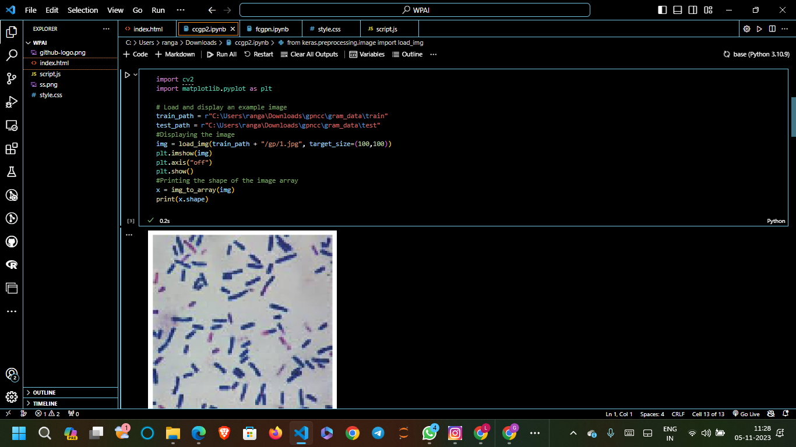
Screenshots

Slide 23
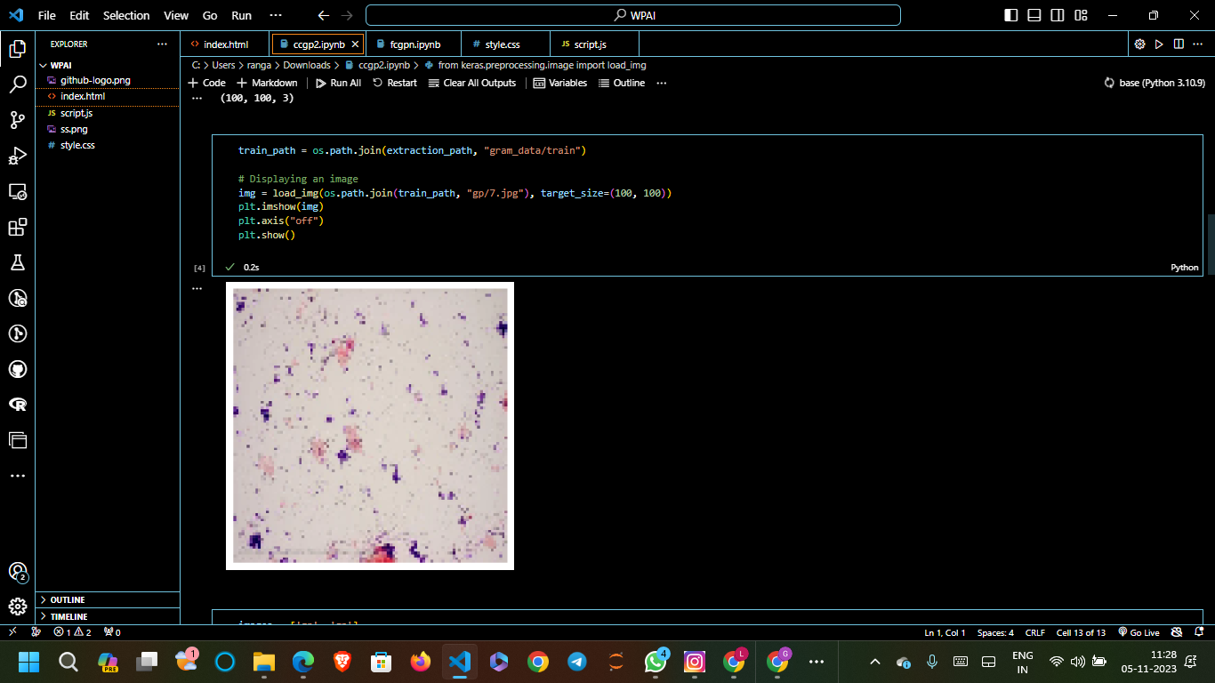
Screenshots

Slide 24
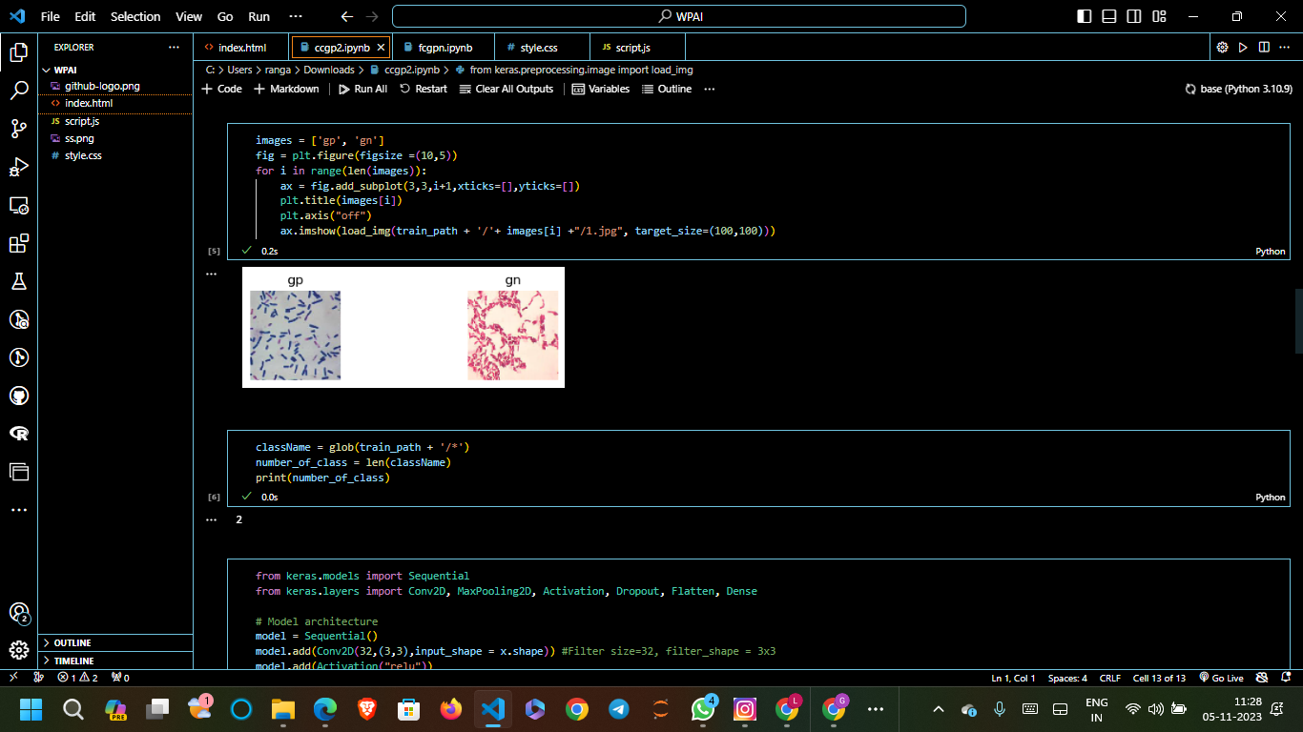
Screenshots

Slide 25

Screenshots

Slide 26

Screenshots

Slide 27

Screenshots

Slide 28

Screenshots

Slide 29

Screenshots

Slide 30
REFERENCES
B. H. Kim and S. Jo, ‘‘Deep physiological affect network for the recognition of human emotions,’’ IEEE Trans. Affect. Comput., vol. 11, no. 2, pp. 230–243, Apr./Jun. 2020.
A. Géron, Hands-on Machine Learning With Scikit-Learn, Keras, and Tensorflow: Concepts, Tools, and Techniques TO Build Intelligent Systems. Sebastopol, CA, USA: O’Reilly Media, 2019.
A. Bäuerle, C. van Onzenoodt, and T. Ropinski, ‘‘Net2 vis—A visual grammar for automatically generating publication-tailored CNN architecture visualizations,’’ IEEE Trans. Vis. Comput. Graphics, vol. 27, no. 6, pp. 2980–2991, Jun. 2021.
P. Schmidt, A. Reiss, R. Dürichen, and K. V. Laerhoven, ‘‘Wearable-based affect recognition—A review,’’ Sensors, vol. 19, no. 19, p. 4079, Sep. 2019.
J. Tervonen, K. Pettersson, and J. Mäntyjärvi, ‘‘Ultra-short window length and feature importance analysis for cognitive load detection from wearable sensors,’’ Electronics, vol. 10, no. 5, pp. 1–19, 2021.
V. Verma, A. Lamb, J. Kannala, Y. Bengio, and D. Lopez-Paz, ‘‘Interpolation consistency training for semi-supervised learning,’’ in Proc. 28th Int. Joint Conf. Artif. Intell., Aug. 2019, pp. 3635–3641.
G. Ding, S. Zhang, S. Khan, Z. Tang, J. Zhang, and F. Porikli, ‘‘Feature affinity-based pseudo labeling for semi-supervised person reidentification,’’ IEEE Trans. Multimedia, vol. 21, no. 11, pp. 2891–2902, Nov. 2019

Slide 31
THANK YOU

